Slide 1
UNIT 12: ROBOTS
GETTING STARTED

Slide 2
1. Listen and read.
WHAT NICE PHOTOS!
Nick: Good morning Dr Alex, can you tell us something about robots, please?
Dr Alex: Yes, of course.
Nick: What do you think about the role of robots in the past?
Dr Alex: Well, in the past they had a minor role. They could only do very simple things.
Phong: What can they do now?
Dr Alex: Now they can do quite a lot. Home robots can do the housework. Doctor robots can help sick people.
Phong: Can they build a house?
Dr Alex: Yes, they can. Worker robots can even build big buildings.
Nick: Can they teach?
Dr Alex: Yes, teaching robots can teach in classes.
Nick: What do you think robots will be able to do in the future?
Dr Alex: Well, I think they will play a very important role. They will be able to do many things like humans.
Phong: Will they be able to talk to us?
Dr Alex: Sure they will. But they won't be able to do things like playing football or driving a car.

Slide 3
EX1a. Answer the following questions
1.What could robots do in the past?
→ They could only do very simple things.
2.Can robots teach?
→ Yes, they can.
3.What will robots be able to do in the future?
→ They will be able to do many things like humans.
4.Will robots be able to play football or drive a car?
→No, they won’t.

Slide 4
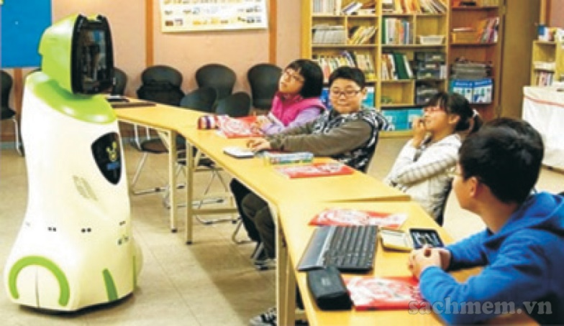
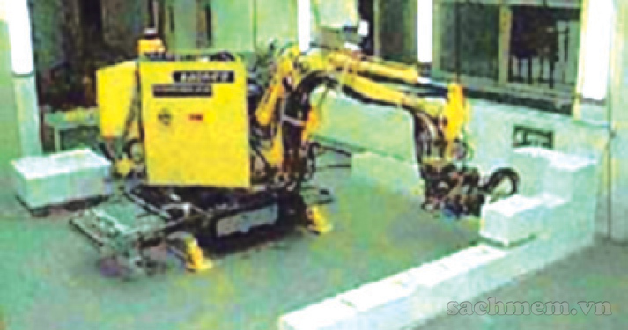
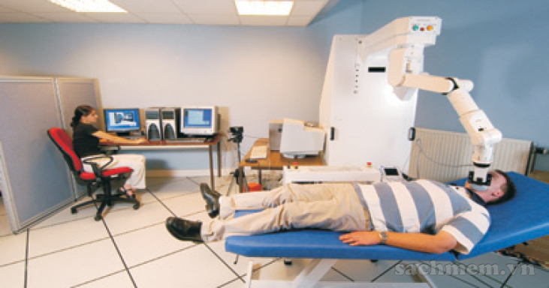
EX1b. Find the types of robots in the conservation
teaching robots
worker robots
doctor robots
home robots

Slide 5
What type of robot is it?
worker robots
teaching robots
doctor robots

Slide 6
What type of robot is it?
worker robots
doctor robots
home robots

Slide 7
What type of robot is it?
teaching robots
home robots
doctor robots

Slide 8
What type of robot is it?
teaching robots
worker robots
home robots

Slide 9
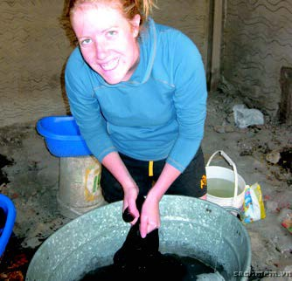
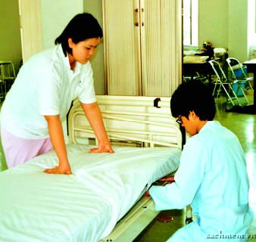
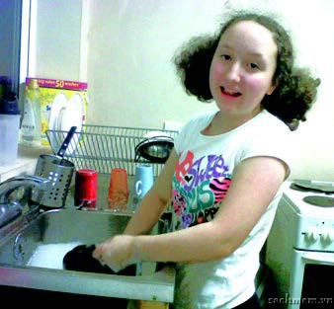
EX2. Match the activities with the pictures.
1.cut the hedge
2.do the dishes
3.do the laundry
4.make the bed
1.do the laundry
2.make the bed
3.cut the hedge
4.do the dishes

Slide 10
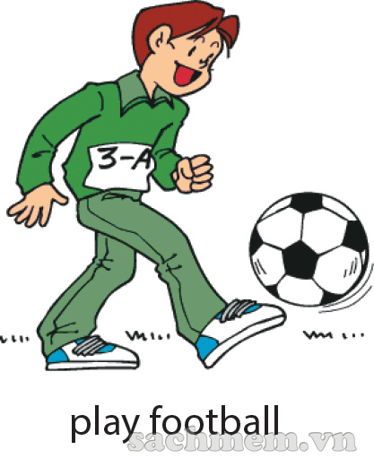
EX4. Look at the pictures. Tell your partner what
you can or can’t do now
I can…………..
I can’t………..

Slide 11
EX5: CLASS SURVEY
Survey questions | Yes | No
1.Can you play table tennis?
2.Can you do karate?
3.Can you play chess?
4.Can you do judo?
5.Can you play badminton?
6.Can you play computer games?

